Slide 1
Case studies
  ABP Meta-Model.
  Concepts ABP Meta-Model.
  Design of the Visualiser.
  CITA Meta-Model.
  Concepts CITA Meta-Model.
  Mapping of CITA meta-model to ArchiMate metamodel
  Visualisation.
  Concepts and their visual representation.
  Tool Design.
  Performance Analysis.

Slide 2
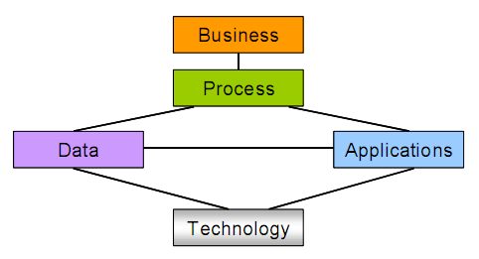
1. ABP Meta-Model.

Slide 3
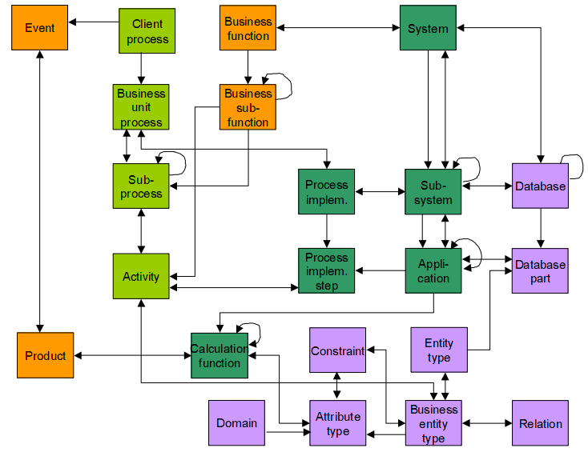
1.ABP Meta-Model

Slide 4
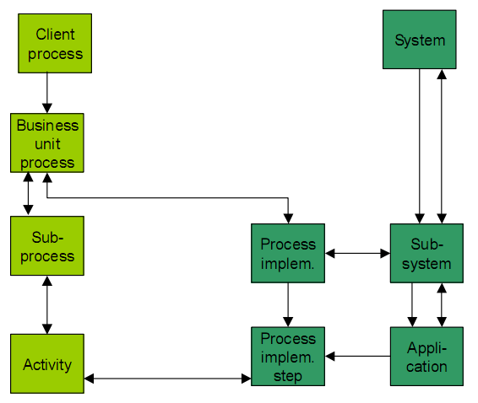
2.Concepts ABP Meta-Model

Slide 5
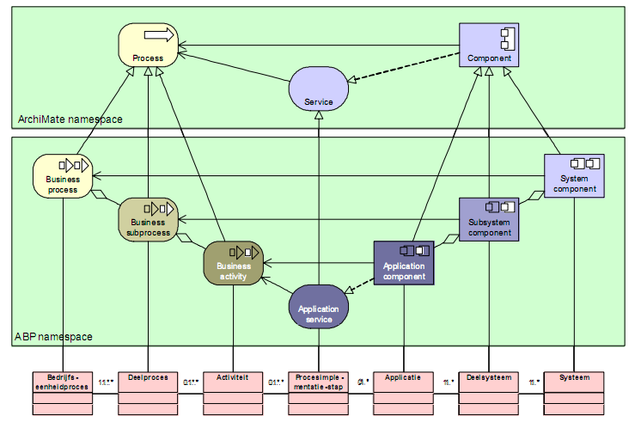
2.Concepts ABP Meta-Model

Slide 6
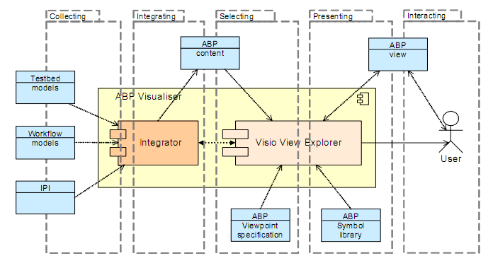
3.Design of the Visualiser

Slide 7
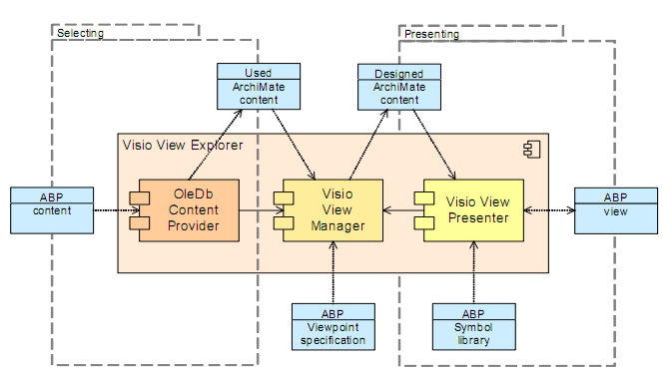
3.Design of the Visualiser

Slide 8
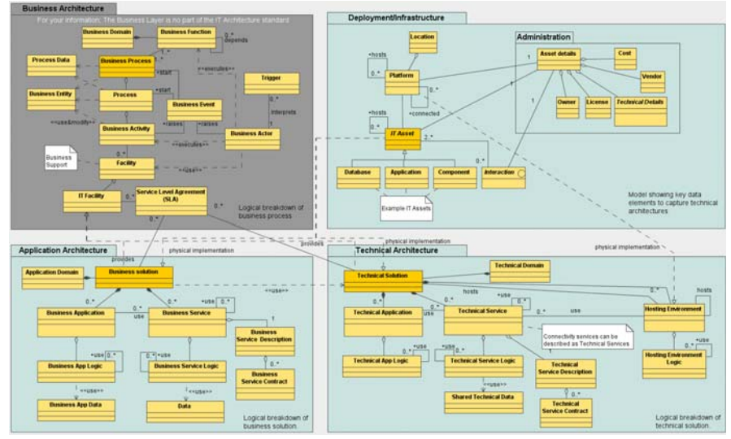
4.CITA Meta-Model

Slide 9
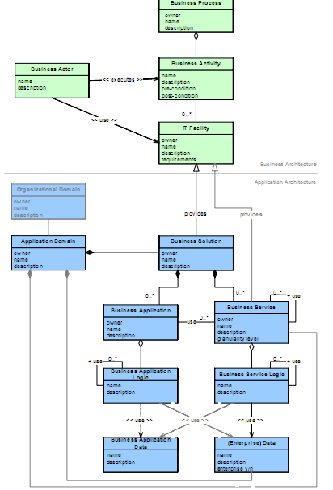
5.Concepts CITA Meta-Model

Slide 10
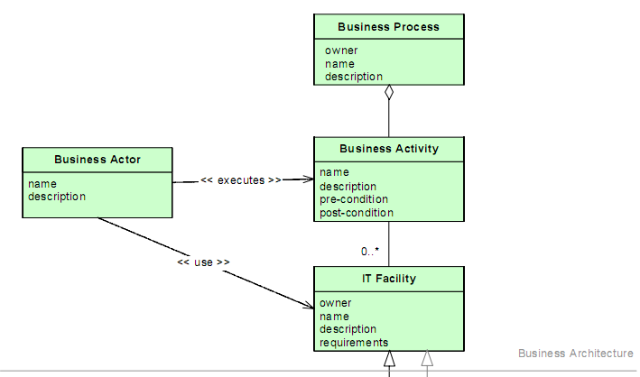
5.Concepts CITA Meta-Model

Slide 11
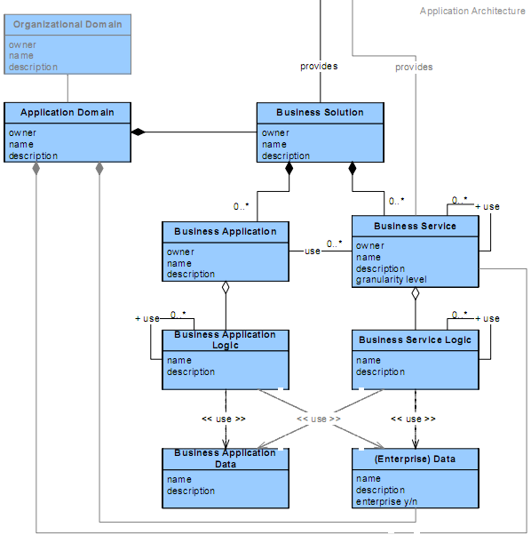
5.Concepts CITA Meta-Model

Slide 12
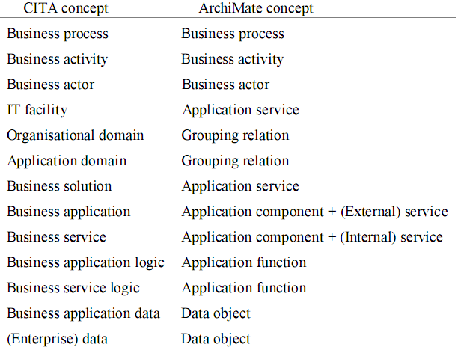
6.Mapping of CITA meta-model to ArchiMate meta-model

Slide 13
7. Visualisation
  To visualise the collected architectural information about the IT systems, the following three types of viewpoints have been identified:
  A global overview of the services and application components (land-scape viewpoint).
  Insight into the support of processes (process support viewpoint).
  Insight into the relations between applications, services, logic, and data(coherence and dependency viewpoint)

Slide 14
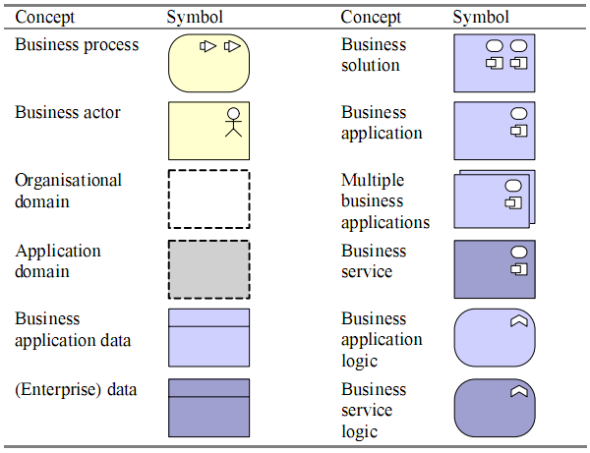
8.Concepts and their visual representation

Slide 15
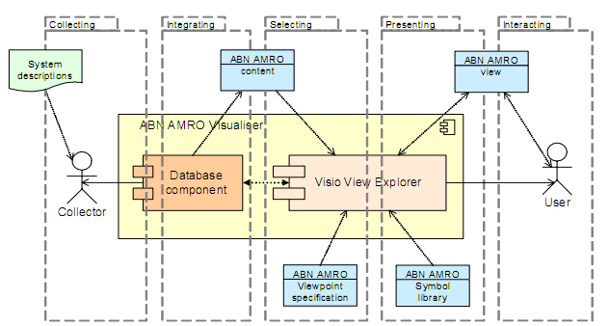
9.Tool Design

Slide 16
Infrastructure Usage
The next step is to take a closer look at the infrastructure support for the application architecture. We first illustrate the modelling approach for the ‘Medium-independent processing’. A layer of infrastructure services supports the various application functions. We distinguish three types of infrastructural services:
  Data storage and access services;
  Processing services;
  Communication services

Slide 17
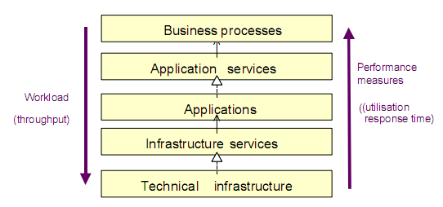
10.Performance Analysis

Slide 18
Analysis Approach
  For the given type of analysis, the following input data is required:
  For each trigger the arrival frequency (average and possibly also peaks).
  For each process, function, or service the average service time.
  For each actor, component, or device the capacity.

Slide 19
Analysis Approach
  Given these inputs, we can estimate the following performance measures:
  For each concept in the model (service, process, function, and resource) the throughput: the number of inputs/outputs that is to be processed per time unit. This is the workload that is imposed by the processes.
  For each actor, component, and device its utilisation: the percentage oftime that it is active.
  For each process, function, and service the average processing time and response time.
  For each client-to-client process the average completion time.

